Slide 1


Requirements AI
+
+
+
+
+
>>Customer<< Workshop XX.YY.ZZZZ
DRIMCO.ai
+
+
+
Confidential ©️ 2026 DRIMCO GmbH

Slide 2


Additional Information
+
+
Hardware Requirements*
 | DRIM NETWORK ZONE
Server | Server1 (DRIM) Windows Server | Server 2 (DRIM AI) Linux Server
Generic Configuration | I 8 Cores I 16GB RAM I 1 TB initial storage I Windows 2019 or 2022 Server | I 32 Cores I 128GB RAM I 1 TB initial storage I Ubuntu 20.4 (or newer), LTS or RHEL 8+
Azure Sizing | Standard_D8_v4 | Standard_D32_v4
AWS Sizing | m5.2xlarge | m5.8xlarge
Recommended Conditions (see MSA for details) | I Up to 100 users / ca. 40 concurrent users at any one time I Up to 100 projects (active and arhived) with an avg. of 500 pages/ project I Ca.10 active projects at one time
+
* Respective TEST/QA (mandatory) and possibly DEV systems must be included. For sizing optimizations please contact DRIMCO.
+
Confidential ©️ 2026 DRIMCO GmbH

Slide 3
Additional Information
+
+
Onboarding Requirements*
Customer Responsibility | DRIMCO Responsibility
Hardware & Operations I Servers Available I Remote Access (VDI, VPN) I Access on DRIM Servers* I DNS & SSL for API, GUI, Polarion I Internet Access | Software deployment* and Configuration I DRIM Installation (Backend, AI, GUI) I Helper Programs I Sanity Check I Connectivity Check (DRIM/ Polarion) I Connectivity Check (user)
Data & Configuration I Training Data for AI Training I DRIM/ Polarion Configuration Spec | I DRIM Configuration I DRIM SAT I DRIM AI Training
DRIM Training I Training Materials I Training Appointments | DRIM Training I Training Appointments I Training Specification / Plan
+
* The deployment methods are in the continuous development and subject to improvements in time.
+
Confidential ©️ 2026 DRIMCO GmbH

Slide 4
Additional Information
+
+
Translation Requirements*
DeepL Pro (API)
https://www.deepl.com/en/pro-api
Microsoft Translator (part of the Cognitive Services) https://learn.microsoft.com/en-us/azure/ai-services/translator/text-translation/overview?tabs=windows
+
* additional costs might incur
+
Confidential ©️ 2026 DRIMCO GmbH

Slide 5




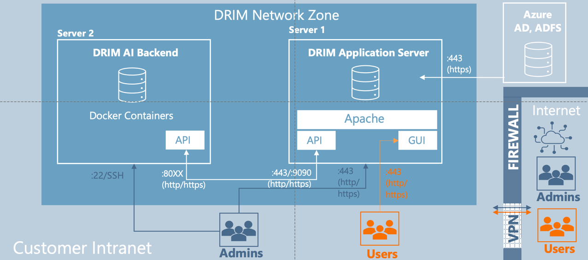
Additional Information
+
+
Architecture Overview (DRIM Only)
DRIM Network
SAML
AD, LDAP
DRIM AI
Backend
DRIM Application Server
:443
(https)
Server 2
Server 1
Docker Containers
Apache
Internet
FIREWALL
API
API
GUI
:80XX
(http/
https)
:443/:9090
(http/
https)
:443
(http/
https)
:443
(http/
https)
Admins
Customer
Network
VPN
:22/SSH
Admins
Users
Users
+
+
Confidential ©️ 2026 DRIMCO GmbH

Slide 6
Additional Information
+
+
Architecture Overview (with Polarion)
DRIM Network
Polarion Network
SAML
AD, LDAP
DRIM AI
Backend
DRIM Application Server
DRIM Application Server
:636
(ldap)
Server 3
Server 2
Server 1
Docker Containers
Apache
Apache
Internet
FIREWALL
API
API
GUI
API
GUI
:80XX
(http/
https)
:443/:9090
(http/
https)
:443
(http/
https)
:443
(http/
https)
:443
(http/
https)
:443
(http/
https)
:3389,:22
(RDP,SSH)
:443
(http/
https)
:443
(http/
https)
Admins
Customer
Network
:22/SSH
VPN
Admins
Users
Users
+
+
Confidential ©️ 2026 DRIMCO GmbH

